Slide 1
Unit 3 Relational Database Model (Database Management Systems)
Application
program
End-user
DBMS

Slide 2
Contents
Relational Model: Basic concepts, Attributes and Domains,
CODD's Rules, Relational Integrity: Domain,
Referential Integrities, Enterprise Constraints,
Database Design: Features of Good Relational Designs,
Normalization,
Atomic Domains and First Normal Form,
Decomposition using Functional Dependencies,
Algorithms for Decomposition, 2NF, 3NF, BCNF,
Modeling Temporal Data.

Slide 3
Relational Database: Definitions
Relational database: a set of relations
Relation: made up of 2 parts:
Schema : specifies name of relation, plus name and type of each column.
e.g. Students(sid: string, name: string, login: string, age: integer, gpa: real)
Instance : a table, with rows and columns. #Rows = cardinality, #fields = degree / arity.
Can think of a relation as a set of rows or tuples (i.e., all rows are distinct).
Columns (attributes) are single-valued
Notes:
3

Slide 4
Example Instance of Students Relation
Cardinality = 3, degree = 5, all rows distinct
Notes:
4

Slide 5
Relational Model
There are several processes and algorithms available to convert ER Diagrams into Relational Schema.
Some of them are automated and some of them are manual. We may focus here on the mapping diagram contents to relational basics.
ER diagrams mainly comprise of −
-Entity and its attributes
-Relationship, which is association among entities.

Slide 6
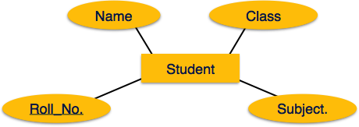
ER diagrams mainly comprise of − 1.Entity and its attributes 2.Relationship, which is association among entities.
Create table for each entity.
Entity's attributes should become fields of tables with their respective data types.
Declare primary key.
Mapping Process (Algorithm)

Slide 7
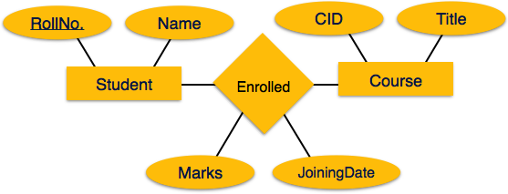
Mapping Relationship A relationship is an association among entities.
Create table for a relationship.
Add the primary keys of all participating Entities as fields of table with their respective data types.
If relationship has any attribute, add each attribute as field of table.
Declare a primary key composing all the primary keys of participating entities.
Declare all foreign key constraints.

Slide 8
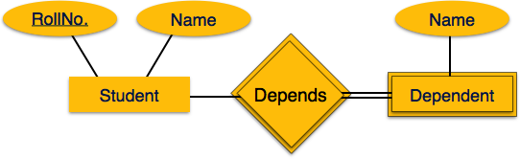
Mapping Weak Entity Sets A weak entity set is one which does not have any primary key associated with it.
Create table for weak entity set.
Add all its attributes to table as field.
Add the primary key of identifying entity set.
Declare all foreign key constraints.

Slide 9
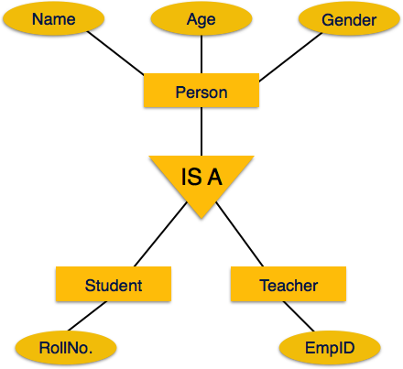
Mapping Hierarchical Entities ER specialization or generalization comes in the form of hierarchical entity sets.
Create tables for all higher-level entities.
Create tables for lower-level entities.
Add primary keys of higher-level entities in the table of lower-level entities.
In lower-level tables, add all other attributes of lower-level entities.
Declare primary key of higher-level table and the primary key for lower-level table.
Declare foreign key constraints.

Slide 10
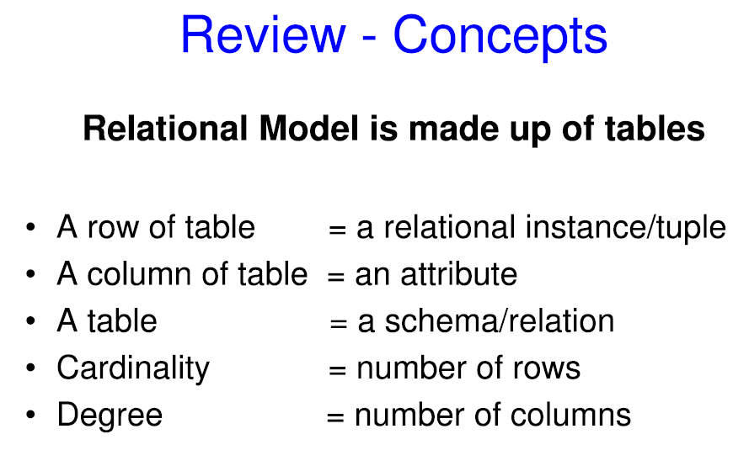

Slide 11

11
The developer
Father of the Relational Data Base
The late Dr. E. F. Codd

Slide 12
12
Dr E F Codd’s Laws
Relational database management
Information representation
Logical accessibility
Representation of null value
Catalog facilities
Data language
View updatability
Insert, update delete
Physical data independent
Logical data independent
Integrity constraints
Database distribution
Non subversion

Slide 13
Codd’s Rules
Rule zero
This rule states that for a system to qualify as an RDBMS, it must be able to manage database entirely through the relational capabilities.
This is a foundation rule, which acts as a base for all the other rules.

Slide 14
Rule 1: Information Rule
The data stored in a database, may it be user data or metadata, must be a value of some table cell. Everything in a database must be stored in a table format.
Rule 2: Guaranteed Access Rule
Every single data element (value) is guaranteed to be accessible logically with a combination of table-name, primary-key (row value), and attribute-name (column value). No other means, such as pointers, can be used to access data.
Each unique piece of data(atomic value) should be accesible by : Table Name + Primary Key(Row) + Attribute(column).

Slide 15
Rule 3: Systematic Treatment of NULL Values
The NULL values in a database must be given a systematic and uniform treatment. This is a very important rule because a NULL can be interpreted as one the following − data is missing, data is not known, or data is not applicable.
Rule 4: Active Online Catalog
The structure description of the entire database must be stored in an online catalog, known as data dictionary, which can be accessed by authorized users. Users can use the same query language to access the catalog which they use to access the database itself.

Slide 16
Rule 5: Comprehensive Data Sub-Language Rule
One well structured language must be there to provide all manners of access to the data stored in the database. Example: SQL, etc. If the database allows access to data without any help of this language, then it is considered as a violation.
Rule 6: View Updating Rule
All the views of a database, which can theoretically be updated, must also be updatable by the system.

Slide 17
Rule 7: High-Level Insert, Update, and Delete Rule
A database must support high-level insertion, updation, and deletion. This must not be limited to a single row, that is, it must also support union, intersection and minus operations to yield sets of data records.
Rule 8: Physical Data Independence
The data stored in a database must be independent of the applications that access the database. Any change in the physical structure of a database must not have any impact on how the data is being accessed by external applications.

Slide 18
Rule 9: Logical Data Independence
The logical data in a database must be independent of its user’s view (application). Any change in logical data must not affect the applications using it. For example, if two tables are merged or one is split into two different tables, there should be no impact or change on the user application. This is one of the most difficult rule to apply.
Rule 10: Integrity Independence
A database must be independent of the application that uses it. All its integrity constraints can be independently modified without the need of any change in the application. This rule makes a database independent of the front-end application and its interface.

Slide 19
Rule 11: Distribution Independence
The end-user must not be able to see that the data is distributed over various locations. Users should always get the impression that the data is located at one site only. This rule has been regarded as the foundation of distributed database systems.
Rule 12: Non-Subversion Rule
If a system has an interface that provides access to low-level records, then the interface must not be able to subvert the system and bypass security and integrity constraints.

Slide 20
20
Database Components
1. Back End Engine
Used for Disk Input/Output processes
(Read/Write/Find)
2. Front End Processor
Data manipulation
String/Arithmetic/Statistical operations
3. DBMS Interface
Data Definition Language (DDL) Data Manipulation Language (DML)
4.Programmer Interface
Applications Environment (4GL’s, Embedded capability)

Slide 21
A Relational Database management System(RDBMS) is a database management system based on the relational model introduced by E.F Codd. In relational model, data is stored in relations(tables) and is represented in form of tuples(rows).

Slide 22
table
ID | Name | Age | Salary
1 | Adam | 34 | 13000
2 | Alex | 28 | 15000
3 | Stuart | 20 | 18000
4 | Ross | 42 | 19020

Slide 23
Tuple
1 | Adam | 34 | 13000

Slide 24
Attribute
A table consists of several records(row), each record can be broken down into several smaller parts of data known as Attributes. The above Employee table consist of four attributes, ID, Name, Age and Salary.

Slide 25
Attribute Domain
When an attribute is defined in a relation(table), it is defined to hold only a certain type of values, which is known as Attribute Domain.
Name
Adam
Alex
Stuart - 9/401, OC Street, Amsterdam
Ross

Slide 26
Relation Schema
A relation schema describes the structure of the relation, with the name of the relation(name of table), its attributes and their names and type.

Slide 27
Relation Key
A relation key is an attribute which can uniquely identify a particular tuple(row) in a relation(table).

Slide 28
Relational Integrity Constraints
Every relation has some conditions that must hold for it to be a valid relation. These conditions are called Relational Integrity Constraints.
There are three main integrity constraints −
Key constraints
Domain constraints
Referential integrity constraints

Slide 29
Key Constraints
There must be at least one minimal subset of attributes in the relation, which can identify a tuple uniquely. This minimal subset of attributes is called key for that relation. (supper key)
If there are more than one such minimal subsets, these are called candidate keys.
Key constraints force that −
in a relation with a key attribute, no two tuples can have identical values for key attributes.
a key attribute can not have NULL values.
Key constraints are also referred as Entity Constraints.

Slide 30
Domain Constraints
Domain constraints refers to the rules defined for the values that can be stored for a certain attribute.
Attributes have specific values in real-world scenario.
we cannot store Address of employee in the column for Name.
Similarly, a mobile number cannot exceed 10 digits.
telephone numbers cannot contain a digit outside 0-9.

Slide 31
Domain Constraints
For example, age can only be a positive integer. The same constraints have been tried to employ on the attributes of a relation.
Every attribute is bound to have a specific range of values.
For example, age cannot be less than zero

Slide 32
Referential integrity Constraints
Referential integrity constraints work on the concept of Foreign Keys.
A foreign key is a key attribute of a relation that can be referred in other relation.
Referential integrity constraint states that if a relation refers to a key attribute of a different or same relation, then that key element must exist.

Slide 33
33
Relations
EMPNUM NAME Date of Birth DEPTNUM
3 JONES 16-05-1956 605 Referencing
7 SMITH 23-09-1965 432 Table
11 ADAMS 11-08-1972 201
15 NGUYEN 23-10-1964 314
18 PHAN 16-11-1976 201
23 SMITH 19-09-1974 314
Relation (Table) Name : EMP
Relation Schema: EMP(empnum,name,date of birth,deptnum)
DEPTNUM DEPTNAME
201 Production
314 Finance
432 Information Systems
605 Administration
Referenced
Table
Relation (Table) Name : DEPT
Relation Schema: DEPT(deptnum, deptname)

Slide 34

Do not
Relational Algebra

Slide 35
Relational Algebra
Relational algebra is a procedural query language, which takes instances of relations as input and yields instances of relations as output.
It uses operators to perform queries. An operator can be either unary or binary.
They accept relations as their input and yield relations as their output.
Relational algebra is performed recursively on a relation and intermediate results are also considered relations.

Slide 36
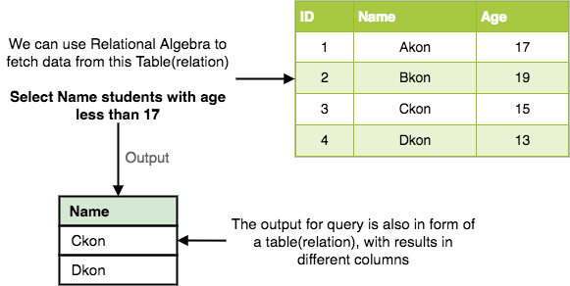
In relational algebra, input is a relation(table from which data has to be accessed) and output is also a relation(a temporary table holding the data asked for by the user).

Slide 37
The fundamental operations
The fundamental operations of relational algebra are as follows Six basic operators
select: σ
project: ∏
union: ∪
set difference: –
Cartesian product: x
rename: ρ

Slide 38
Select Operation (σ) This is used to fetch rows(tuples) from table(relation) which satisfies a given condition.It selects tuples that satisfy the given predicate from a relation. Notation − σ_{p}(r)
Where σ stands for selection predicate and r stands for relation. p is prepositional logic formula which may use connectors like and, or, and not. These terms may use relational operators like − =, ≠, ≥, < , >, ≤.
For example −
σ_{subject = "database"}(Books)
Output − Selects tuples from books where subject is 'database'.
σsubject = "database" and price = "450"(Books)
Output − Selects tuples from books where subject is 'database' and 'price' is 450.

Slide 39
fetch data for students with age more than 17.
σ_{age > 17} (Student)
Fetch data of male students, of age more than 17.
σ_{age > 17 and gender = 'Male'} (Student)

Slide 40
Select Operation – Example
Relation r
A
B
C
D
α
α
β
β
α
β
β
β
1
5
12
23
7
7
3
10
σ_{A=B ^ D > 5} (r)
A
B
C
D
α
β
α
β
1
23
7
10

Slide 41
Select Operation
Example of selection: σ _{branch_name=“Perryridge”}(account)

Slide 42
Project Operation (∏)
Project operation is used to project only a certain set of attributes of a relation.
In simple words, If you want to see only the names all of the students in the Student table, then you can use Project Operation.

Slide 43
Project Operation (∏) It projects column(s) that satisfy a given predicate. Notation − ∏_{A1, A2, An} (r)
Where A₁, A₂ , A_{n} are attribute names of relation r.
Duplicate rows are automatically eliminated, as relation is a set.
For example −
∏_{subject, author} (Books)
Selects and projects columns named as subject and author from the relation Books.

Slide 44
Project Operation – Example
A
B
C
Relation r:
α
α
β
β
10
20
30
40
1
1
1
2
A
C
A
C
∏_{A,C} (r)
α
α
β
β
1
1
1
2
α
β
β
1
1
2
=

Slide 45
Union Operation (∪)
This operation is used to fetch data from two relations(tables) or temporary relation(result of another operation).
For this operation to work, the relations(tables) specified should have same number of attributes(columns) and same attribute domain. Also the duplicate tuples are autamatically eliminated from the result.
Syntax: A ∪ B
where A and B are relations.

Slide 46
It performs binary union between two given relations and is defined as − r ∪ s = { t | t ∈ r or t ∈ s} Notation − r U s
Where r and s are either database relations or relation result set (temporary relation).
For a union operation to be valid, the following conditions must hold −
1. r, and s must have the same number of attributes.
2. Attribute domains must be compatible.
3. Duplicate tuples are automatically eliminated.
∏ _{author} (Books) ∪ ∏ _{author} (Articles)
Output − Projects the names of the authors who have either written a book or an article or both.

Slide 47
if we have two tables RegularClass and ExtraClass, both have a column student to save name of student, then,
name of Students who are attending both regular classes and extra classes, eliminating repetition.
∏Student(RegularClass) ∪ Student(ExtraClass)

Slide 48
Project Operation – Example
A
B
C
Relation r:
α
α
β
β
10
20
30
40
1
1
1
2
A
C
A
C
∏_{A,C} (r)
α
α
β
β
1
1
1
2
α
β
β
1
1
2
=

Slide 49
Set Difference (−) The result of set difference operation is tuples, which are present in one relation but are not in the second relation. Notation − r − s
Finds all the tuples that are present in r but not in s.
∏ _{author} (Books) − ∏ _{author} (Articles)
Output − Provides the name of authors who have written books but not articles.
find name of students who attend the regular class but not the extra class, then, we can use the below operation:
∏Student(RegularClass) - ∏Student(ExtraClass)

Slide 50
Set Difference Operation – Example
Relations r, s:
A
B
A
B
α
α
β
1
2
1
α
β
2
3
s
r
r – s:
A
B
α
β
1
1

Slide 51
Cartesian Product (Χ) Combines information of two different relations into one. Notation − r Χ s
Where r and s are relations and their output will be defined as −
r Χ s = { q t | q ∈ r and t ∈ s}
σ_{author = 'tutorialspoint'}(Books Χ Articles)
Output − Yields a relation, which shows all the books and articles written by tutorialspoint.

Slide 52
Cartesian-Product Operation – Example
Relations r, s:
A
B
C
D
E
α
β
1
2
α
β
β
γ
10
10
20
10
a
a
b
b
r
s
r x s:
A
B
C
D
E
α
α
α
α
β
β
β
β
1
1
1
1
2
2
2
2
α
β
β
γ
α
β
β
γ
10
10
20
10
10
10
20
10
a
a
b
b
a
a
b
b

Slide 53
Rename Operation (ρ) The results of relational algebra are also relations but without any name. The rename operation allows us to rename the output relation. 'rename' operation is denoted with small Greek letter rho ρ. Notation − ρ _{x} (E)
Where the result of expression E is saved with name of x.
ρ(RelationNew, RelationOld)

Slide 54
Banking Example
branch (branch_name, branch_city, assets)
customer (customer_name, customer_street, customer_city)
account (account_number, branch_name, balance)
loan (loan_number, branch_name, amount)
depositor (customer_name, account_number)
borrower (customer_name, loan_number)

Slide 55
Example Queries
Find all loans of over $1200
σ_{amount > 1200} (loan)
Find the loan number for each loan of an amount greater than $1200
∏_{loan_number} (σ_{amount} _{> 1200} (loan))
Find the names of all customers who have a loan, an account, or both, from the bank
∏_{customer_name} (borrower) ∪ ∏_{customer_name} (depositor)

Slide 56
Example Queries
Find the names of all customers who have a loan at the Perryridge branch.
∏_{customer_name} (σ_{branch_name=“Perryridge”}
(σborrower.loan_number = loan.loan_number(borrower x loan)))
Find the names of all customers who have a loan at the Perryridge branch but do not have an account at any branch of the bank.
∏_{customer_name} (σ_{branch_name = “Perryridge”}
(σborrower.loan_number = loan.loan_number(borrower x loan))) – ∏_{customer_name}(depositor)

Slide 57
Example Queries
Find the names of all customers who have a loan at the Perryridge branch.
Query 1 ∏_{customer_name} (σ_{branch_name = “Perryridge”} ( σborrower.loan_number = loan.loan_number (borrower x loan)))
Query 2
∏_{customer_name}(σloan.loan_number = borrower.loan_number ( (σ_{branch_name = “Perryridge”} (loan)) x borrower))

Slide 58
Example Queries
Find the largest account balance
Strategy:
Find those balances that are not the largest
Rename account relation as d so that we can compare each account balance with all others
Use set difference to find those account balances that were not found in the earlier step.
The query is:
∏_{balance}(account) - ∏_{account.balance}
(σ_{account.balance < d.balance} (account x ρ_{d} (account)))

Slide 60
Normalization
Normalization is a systematic approach of decomposing tables to eliminate data redundancy(repetition) and undesirable characteristics like Insertion, Update and Deletion Anamolies.
It is a multi-step process that puts data into tabular form, removing duplicated data from the relation tables.
Normalization is used for mainly two purposes,
Eliminating reduntant(useless) data.
Ensuring data dependencies make sense i.e data is logically stored.

Slide 61
Normalization
Normalization is a process that “improves” a database design by generating relations that are of higher normal forms.
The objective of normalization:
“to create relations where every dependency is on the key, the whole key, and nothing but the key”.

Slide 62
Problems Without Normalization
extra memory space but will also make it difficult to handle and update the database, without facing data loss. Insertion, Updation and Deletion Anamolies are very frequent if database is not normalized.
rollno | name | branch | hod | office_tel
401 | Akon | CSE | Mr. X | 53337
402 | Bkon | CSE | Mr. X | 53337
403 | Ckon | CSE | Mr. X | 53337
404 | Dkon | CSE | Mr. X | 53337

Slide 63
Updation Anomaly
Insertion Anomaly
Deletion Anomaly

Slide 64
Insertion Anomaly
Suppose for a new admission, until and unless a student opts for a branch, data of the student cannot be inserted, or else we will have to set the branch information as NULL.
Also, if we have to insert data of 100 students of same branch, then the branch information will be repeated for all those 100 students.
These scenarios are nothing but Insertion anomalies.

Slide 65
Updation Anomaly
What if Mr. X leaves the college? or is no longer the HOD of computer science department?
In that case all the student records will have to be updated, and if by mistake we miss any record, it will lead to data inconsistency. This is Updation anomaly.

Slide 66
Deletion Anomaly
In our Student table, two different informations are kept together, Student information and Branch information.
Hence, at the end of the academic year, if student records are deleted, we will also lose the branch information.
This is Deletion anomaly.

Slide 67
Functional Dependencies
Functional Dependencies
We say an attribute, B, has a functional dependency on another attribute, A, if for any two records, which have
the same value for A, then the values for B in these two records must be the same. We illustrate this as:
A → B
Example: Suppose we keep track of employee email addresses, and we only track one email address for each employee. Suppose each employee is identified by their unique employee number. We say there is a functional dependency of email address on employee number:
employee number → email address

Slide 68
Functional Dependencies
EmpNum
EmpEmail
EmpFname
EmpLname
123
jdoe@abc.com
John
Doe
456
psmith@abc.com
Peter
Smith
555
alee1@abc.com
Alan
Lee
633
pdoe@abc.com
Peter
Doe
787
alee2@abc.com
Alan
Lee
If EmpNum is the PK then the FDs:
EmpNum → EmpEmail
EmpNum → EmpFname
EmpNum → EmpLname
must exist.

Slide 69
Functional Dependencies
EmpNum → EmpEmail
EmpNum → EmpFname
EmpNum → EmpLname
3 different ways you might see FDs depicted
EmpEmail
EmpNum
EmpFname
EmpLname
EmpNum EmpEmail EmpFname EmpLname

Slide 70
Determinant
Functional Dependency
EmpNum → EmpEmail
Attribute on the LHS is known as the determinant
EmpNum is a determinant of EmpEmail

Slide 71
Transitive dependency
Transitive dependency
Consider attributes A, B, and C, and where
A → B and B → C.
Functional dependencies are transitive, which means that we also have the functional dependency A → C
We say that C is transitively dependent on A through B.

Slide 72
Transitive dependency
EmpNum → DeptNum
EmpNum EmpEmail DeptNum DeptNname
DeptNum → DeptName
EmpNum EmpEmail DeptNum DeptNname
DeptName is transitively dependent on EmpNum via DeptNum
EmpNum → DeptName

Slide 73
Partial dependency
A partial dependency exists when an attribute B is functionally dependent on an attribute A, and A is a component of a multipart candidate key.
InvNum
LineNum
Qty
InvDate
Candidate keys: {InvNum, LineNum} InvDate is partially dependent on {InvNum, LineNum} as InvNum is a determinant of InvDate and InvNum is part of a candidate key

Slide 74
Normalization Rule
Normalization rules are divided into the following normal forms:
1NF is considered the weakest,
2NF is stronger than 1NF,
3NF is stronger than 2NF, and
BCNF is considered the strongest
Fourth Normal Form
any relation that is in BCNF, is in 3NF;
any relation in 3NF is in 2NF; and
any relation in 2NF is in 1NF.

Slide 75
Normalization
1NF
a relation in BCNF, is also in 3NF
a relation in 3NF is also in 2NF
a relation in 2NF is also in 1NF
2NF
3NF
BCNF

Slide 76
First Normal Form (1NF)
If tables in a database are not even in the 1st Normal Form, it is considered as bad database design.
For a table to be in the First Normal Form, it should follow the following 4 rules:
It should only have single(atomic) valued attributes/columns.
Values stored in a column should be of the same domain
All the columns in a table should have unique names.
And the order in which data is stored, does not matter.

Slide 77
3 different students in our table, 2 have opted for more than 1 subject. And we have stored the subject names in a single column. But as per the 1st Normal form each column must contain atomic value.
roll_no | name | subject
101 | Akon | OS, CN
103 | Ckon | Java
102 | Bkon | C, C++

Slide 78
How to solve this Problem?
roll_no | name | subject
101 | Akon | OS
101 | Akon | CN
103 | Ckon | Java
102 | Bkon | C
102 | Bkon | C++

Slide 79
First Normal Form
The following in not in 1NF
EmpNum
EmpPhone
EmpDegrees
123
233-9876
333
233-1231
BA, BSc, PhD
679
233-1231
BSc, MSc
EmpDegrees is a multi-valued field:
employee 679 has two degrees: BSc and MSc
employee 333 has three degrees: BA, BSc, PhD

Slide 80
First Normal Form
EmpNum
EmpPhone
EmpDegrees
123
233-9876
333
233-1231
BA, BSc, PhD
679
233-1231
BSc, MSc
To obtain 1NF relations we must, without loss of information, replace the above with two relations - see next slide

Slide 81
First Normal Form
EmployeeDegree
Employee
EmpNum
EmpDegree
EmpNum
EmpPhone
333
BA
123
233-9876
333
BSc
333
233-1231
333
PhD
679
233-1231
679
BSc
679
MSc
An outer join between Employee and EmployeeDegree will produce the information we saw before

Slide 82
Second Normal Form (2NF)
For a table to be in the Second Normal Form,
It should be in the First Normal form.
And, it should not have Partial Dependency.

Slide 83
Functional Dependency.
student_id | name | reg_no | branch | address
subject_id | subject_name
1 | Java
2 | C++
3 | Php
student_id is the primary key and will be unique for every row, hence we can use student_id to fetch any row of data from this table
This is Dependency and we also call it Functional Dependency.

Slide 84
What is Partial Dependency?
score_id | student_id | subject_id | marks | teacher
1 | 10 | 1 | 70 | Java Teacher
2 | 10 | 2 | 75 | C++ Teacher
3 | 11 | 1 | 80 | Java Teacher
student_id + subject_id forms a Candidate for this table, which can be the Primary key.
to get me marks of student with student_id 10, can you get it from this table? No,
Hence we need student_id + subject_id to uniquely identify any row.

Slide 85
What is Partial Dependency?
column names teacher which is only dependent on the subject, for Java it's Java Teacher and for C++ it's C++ Teacher & so on.
the teacher's name only depends on subject, hence the subject_id, and has nothing to do with student_id.
This is Partial Dependency, where an attribute in a table depends on only a part of the primary key and not on the whole key.

Slide 86
How to remove Partial Dependency?
remove columns teacher from Score table and add it to the Subject table. Hence, the Subject table will become:
subject_id | subject_name | teacher
1 | Java | Java Teacher
2 | C++ | C++ Teacher
3 | Php | Php Teacher
score_id | student_id | subject_id | marks
1 | 10 | 1 | 70
2 | 10 | 2 | 75
3 | 11 | 1 | 80

Slide 87
Second Normal Form
Consider this InvLine table (in 1NF):
InvNum
LineNum
ProdNum
Qty
InvDate
InvNum, LineNum
ProdNum, Qty
There are two candidate keys.
Qty is the only non-key attribute, and it is dependent on InvNum
InvNum
InvDate
Since there is a determinant that is not a candidate key, InvLine is not BCNF
InvLine is not 2NF since there is a partial dependency of InvDate on InvNum
InvLine is only in 1NF

Slide 88
Second Normal Form
InvLine
InvNum
LineNum
ProdNum
Qty
InvDate
The above relation has redundancies: the invoice date is repeated on each invoice line.
We can improve the database by decomposing the relation into two relations:
InvNum
LineNum
ProdNum
Qty
InvNum
InvDate
Question: What is the highest normal form for these relations? 2NF? 3NF? BCNF?

Slide 89
Quick Recap
For a table to be in the Second Normal form, it should be in the First Normal form and it should not have Partial Dependency.
Partial Dependency exists, when for a composite primary key, any attribute in the table depends only on a part of the primary key and not on the complete primary key.
To remove Partial dependency, we can divide the table, remove the attribute which is causing partial dependency, and move it to some other table where it fits in well.

Slide 90
Third Normal Form (3NF)
A table is said to be in the Third Normal Form when,
It is in the Second Normal form.
And, it doesn't have Transitive Dependency.

Slide 91
subject_id | subject_name | teacher
1 | Java | Java Teacher
2 | C++ | C++ Teacher
3 | Php | Php Teacher
student_id | name | reg_no | branch | address
10 | Akon | 07-WY | CSE | Kerala
11 | Akon | 08-WY | IT | Gujarat
12 | Bkon | 09-WY | IT | Rajasthan
score_id | student_id | subject_id | marks
1 | 10 | 1 | 70
2 | 10 | 2 | 75
3 | 11 | 1 | 80

Slide 92
What is Transitive Dependency?
score_id | student_id | subject_id | marks | exam_name | total_marks
student_id + subject_id.----pk
exam_name is dependent on both student_id and subject_id.
total_marks depends on exam_name as with exam type the total score changes
This is Transitive Dependency. When a non-prime attribute depends on other non-prime attributes rather than depending upon the prime attributes or primary key.

Slide 93
How to remove Transitive Dependency?
Take out the columns exam_name and total_marks from Score table and put them in an Exam table and use the exam_id wherever required.
score_id | student_id | subject_id | marks | exam_id
Exam_id | exam_name | total_marks
1 | Workshop | 200
2 | Mains | 70
3 | Practicals | 30

Slide 94
Third Normal Form
Consider this Employee relation
Candidate keys are? …
EmpNum
EmpName
DeptNum
DeptName
EmpName, DeptNum, and DeptName are non-key attributes.
DeptNum determines DeptName, a non-key attribute, and DeptNum is not a candidate key.
Is the relation in 3NF? … no
Is the relation in 2NF? … yes
Is the relation in BCNF? … no

Slide 95
Third Normal Form
EmpNum
EmpName
DeptNum
DeptName
We correct the situation by decomposing the original relation into two 3NF relations. Note the decomposition is lossless.
EmpNum
EmpName
DeptNum
DeptNum
DeptName
Verify these two relations are in 3NF.

Slide 96
Boyce and Codd Normal Form (BCNF)
Boyce-Codd Normal Form or BCNF is an extension to the third normal form, and is also known as 3.5 Normal Form.
For a table to satisfy the Boyce-Codd Normal Form, it should satisfy the following two conditions:
It should be in the Third Normal Form.
And, for any dependency A → B, A should be a super key.

Slide 97
student_id, subject together form the primary key
student_id | subject | professor
101 | Java | P.Java
101 | C++ | P.Cpp
102 | Java | P.Java2
103 | C# | P.Chash
104 | Java | P.Java
one professor teaches only one subject, but one subject may have two different professors.
Hence, there is a dependency between subject and professor here, where subject depends on the professor name.

Slide 98
student_id, subject form primary key, which means subject column is a prime attribute.
professor → subject.
subject is a prime attribute, professor is a non-prime attribute, which is not allowed by BCNF.

Slide 99
How to satisfy BCNF?
decompose this table into two tables, student table and professor table.
student_id | p_id
101 | 1
101 | 2
and so on...
p_id | professor | subject
1 | P.Java | Java
2 | P.Cpp | C++
and so on...

Slide 100
Fourth Normal Form (4NF)
A table is said to be in the Fourth Normal Form when,
It is in the Boyce-Codd Normal Form.
And, it doesn't have Multi-Valued Dependency.

Slide 101
s_id | course | hobby
1 | Science | Cricket
1 | Maths | Hockey
2 | C# | Cricket
2 | Php | Hockey
multi-value dependency, which leads to un-necessary repetition of data and other anomalies as well.

Slide 102
How to satisfy 4th Normal Form?
decompose the table into 2 tables.
s_id | course
1 | Science
1 | Maths
2 | C#
2 | Php
s_id | hobby
1 | Cricket
1 | Hockey
2 | Cricket
2 | Hockey

